Slide 1
Chapter 11

Slide 2

Topics
Merge-sort
Quick-sort
A lower bound on sort
Bucket-sort and Radix sort
Selection
Sets and Unions

Slide 3

Merge Sort
7 2 ⏐ 9 4 → 2 4 7 9
7 ⏐ 2 → 2 7
9 ⏐ 4 → 4 9
7 → 7
2 → 2
9 → 9
4 → 4

Slide 4

Divide-and-Conquer
Divide-and conquer is a general algorithm design paradigm:
Divide: If the input size is smaller than a certain threshold, solve the problem directly using a straightforward method and return the solution obtained, otherwise divide the input into two or more disjoint subsets
Recur: Recursively solve the sub-problems associated with the subsets
Conquer: Take the solution to the sub-problems and merge then into a solution to the original problem

Slide 5

Merge-Sort
Merge-sort is a sorting algorithm based on the divide-and-conquer paradigm
Like the heap-sort
It uses a comparator
It runs in O(n log n) time
Unlike the heap-sort
It does not use an auxiliary priority queue
It accesses data in a sequential manner (suitable to sort data on a disk)

Slide 6

Using Divide-and-Conquer for Sorting
A merge-sort on an input sequence S with n elements using a comparator consists of three steps based on the divide-and-conquer paradigm
Divide: partition S into two sequences S₁ and S₂ of about n/2 elements each
S₁ contains the first elements and S₂ contains the remaining elements
Recur: recursively sort S₁ and S₂
Conquer: merge S₁ and S₂ into a sorted sequence

Slide 7
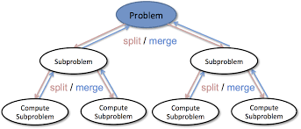
Divide-and-Conquer

Slide 8
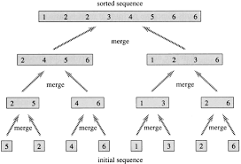
Merge-Sort Algorithm
Algorithm mergeSort(S, C)
Input: sequence S with n elements, comparator C
Output: sequence S sorted according to C
if S.size() > 1
(S₁, S₂) ← partition(S, n/2)
mergeSort(S₁, C)
mergeSort(S₂, C)
S ← merge(S₁, S₂)

Slide 9
Merging Two Sorted Sequences
The conquer step of merge-sort consists of merging two sorted sequences A and B into a sorted sequence S containing the union of the elements of A and B
Merging two sorted sequences, each with n/2 elements and implemented by means of a doubly linked list, takes O(n) time

Slide 10
Merging Two Sorted Sequences
Algorithm merge(A, B)
Input sequences A and B with n/2 elements each
Output sorted sequence of A ∪ B
S ← empty sequence
while ¬A.empty() ∧ ¬B.empty()
if A.front() < B.front()
S.addBack(A.front()); A.eraseFront();
else
S.addBack(B.front()); B.eraseFront();
while ¬A.empty()
S.addBack(A.front()); A.eraseFront();
while ¬B.empty()
S.addBack(B.front()); B.eraseFront();
return S

Slide 11
Merge-Sort Tree (1)
An execution of merge-sort is depicted by a binary tree
Each node represents a recursive call of merge-sort algorithm
Each node v of T is processed by the call associated with v
The children of node v are associated with the recursive call that process the subsequences S₁ and S₂

Slide 12
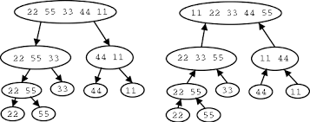
Merge-Sort Tree (2)
Unsorted sequence before the execution
Sorted sequence at the end of the execution
The external nodes are associated with the individual elements of S
The root is the initial call

Slide 13
Merge-Sort Tree
7 2 ⏐ 9 4 → 2 4 7 9
7 ⏐ 2 → 2 7
9 ⏐ 4 → 4 9
7 → 7
2 → 2
9 → 9
4 → 4

Slide 14
Execution Example (1)
Partition
7 2 9 4 ⏐ 3 8 6 1 → 1 2 3 4 6 7 8 9
7 2 9 4 → 2 4 7 9
3 8 6 1 → 1 3 8 6
7 2 → 2 7
9 4 → 4 9
3 8 → 3 8
6 1 → 1 6
7 → 7
2 → 2
9 → 9
4 → 4
3 → 3
8 → 8
6 → 6
1 → 1

Slide 15
Execution Example (2)
Recursive call, partition
7 2 9 4 ⏐ 3 8 6 1 → 1 2 3 4 6 7 8 9
7 2 ⏐ 9 4 → 2 4 7 9
3 8 6 1 → 1 3 8 6
7 2 → 2 7
9 4 → 4 9
3 8 → 3 8
6 1 → 1 6
7 → 7
2 → 2
9 → 9
4 → 4
3 → 3
8 → 8
6 → 6
1 → 1

Slide 16
Execution Example (3)
Recursive call, partition
7 2 9 4 ⏐ 3 8 6 1 → 1 2 3 4 6 7 8 9
7 2 ⏐ 9 4 → 2 4 7 9
3 8 6 1 → 1 3 8 6
7 ⏐ 2 → 2 7
9 4 → 4 9
3 8 → 3 8
6 1 → 1 6
7 → 7
2 → 2
9 → 9
4 → 4
3 → 3
8 → 8
6 → 6
1 → 1

Slide 17
Execution Example (4)
Recursive call, base case
7 2 9 4 ⏐ 3 8 6 1 → 1 2 3 4 6 7 8 9
7 2 ⏐ 9 4 → 2 4 7 9
3 8 6 1 → 1 3 8 6
7 ⏐ 2 → 2 7
9 4 → 4 9
3 8 → 3 8
6 1 → 1 6
7 → 7
2 → 2
9 → 9
4 → 4
3 → 3
8 → 8
6 → 6
1 → 1

Slide 18
Execution Example (5)
Recursive call, base case
7 2 9 4 ⏐ 3 8 6 1 → 1 2 3 4 6 7 8 9
7 2 ⏐ 9 4 → 2 4 7 9
3 8 6 1 → 1 3 8 6
7 ⏐ 2 → 2 7
9 4 → 4 9
3 8 → 3 8
6 1 → 1 6
7 → 7
2 → 2
9 → 9
4 → 4
3 → 3
8 → 8
6 → 6
1 → 1

Slide 19
Execution Example (6)
Merge
7 2 9 4 ⏐ 3 8 6 1 → 1 2 3 4 6 7 8 9
7 2 ⏐ 9 4 → 2 4 7 9
3 8 6 1 → 1 3 8 6
7 ⏐ 2 → 2 7
9 4 → 4 9
3 8 → 3 8
6 1 → 1 6
7 → 7
2 → 2
9 → 9
4 → 4
3 → 3
8 → 8
6 → 6
1 → 1

Slide 20
Execution Example (7)
Recursive call, …, base case, merge
7 2 9 4 ⏐ 3 8 6 1 → 1 2 3 4 6 7 8 9
7 2 ⏐ 9 4 → 2 4 7 9
3 8 6 1 → 1 3 8 6
7 ⏐ 2 → 2 7
9 4 → 4 9
3 8 → 3 8
6 1 → 1 6
7 → 7
2 → 2
9 → 9
4 → 4
3 → 3
8 → 8
6 → 6
1 → 1

Slide 21
Execution Example (8)
Merge
7 2 9 4 ⏐ 3 8 6 1 → 1 2 3 4 6 7 8 9
7 2 ⏐ 9 4 → 2 4 7 9
3 8 6 1 → 1 3 8 6
7 ⏐ 2 → 2 7
9 4 → 4 9
3 8 → 3 8
6 1 → 1 6
7 → 7
2 → 2
9 → 9
4 → 4
3 → 3
8 → 8
6 → 6
1 → 1

Slide 22
Execution Example (9)
Recursive call, …, merge, merge
7 2 9 4 ⏐ 3 8 6 1 → 1 2 3 4 6 7 8 9
7 2 ⏐ 9 4 → 2 4 7 9
3 8 6 1 → 1 3 6 8
7 ⏐ 2 → 2 7
9 4 → 4 9
3 8 → 3 8
6 1 → 1 6
7 → 7
2 → 2
9 → 9
4 → 4
3 → 3
8 → 8
6 → 6
1 → 1

Slide 23
Execution Example (10)
Merge
7 2 9 4 ⏐ 3 8 6 1 → 1 2 3 4 6 7 8 9
7 2 ⏐ 9 4 → 2 4 7 9
3 8 6 1 → 1 3 6 8
7 ⏐ 2 → 2 7
9 4 → 4 9
3 8 → 3 8
6 1 → 1 6
7 → 7
2 → 2
9 → 9
4 → 4
3 → 3
8 → 8
6 → 6
1 → 1

Slide 24
Analysis of Merge-Sort
The height h of the merge-sort tree is O(log n)
at each recursive call one divides in half the sequence
The overall amount or work done at the nodes of depth i is O(n)
One partitions and merges 2^{i} sequences of size n/2^{i}
One makes 2^{i+1} recursive calls
The total running time of merge-sort is O(n log n)
depth | #seqs | size
0 | 1 | n
1 | 2 | n/2
i | 2^{i} | n/2^{i}
… | … | …

Slide 25
Summary of Sorting Algorithms
Algorithm | Time | Notes
selection-sort | O(n²) | slow in-place for small data sets (< 1K)
insertion-sort | O(n²) | slow in-place for small data sets (< 1K)
heap-sort | O(n log n) | fast in-place for large data sets (1K — 1M)
merge-sort | O(n log n) | fast sequential data access for huge data sets (> 1M)
Chapter 8
Chapter 8

Slide 26
Quick-Sort
7 4 9 6 2 → 2 4 6 7 9
4 2 → 2 4
7 9 → 7 9
2 → 2
9 → 9

Slide 27
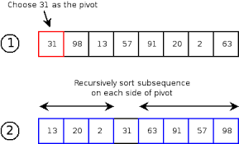
Quick-Sort
Quick-sort is based on the divide-and-conquer paradigm where most of the work is done before the recursive calls
Divide: pick a random element x (called pivot) and partition S into (common practice is to choose the last element of S)
L stores elements less than x
E stores elements equal x
G stores elements greater than x
Recur: Recursively sort L and G
Conquer: Put back the elements into S by concatenating the elements of L, followed by elements of E, then followed by the elements of G

Slide 28
Quick-Sort
x
x
L
G
E
x

Slide 29
Quick-Sort Details (1)
One partitions an input sequence as follows:
One removes, in turn, each element y from S and
One inserts y into L, E or G, depending on the result of the comparison with the pivot x
Each insertion and removal is at the beginning or at the end of a sequence, and hence takes O(1) time
Thus, the partition step of quick-sort takes O(n) time

Slide 30
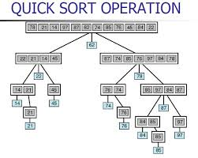
Quick-Sort Details (2)
Algorithm partition(S, p)
Input sequence S, position p of pivot
Output subsequences L, E, G of the elements of S less than, equal to, or greater than the pivot, resp.
L, E, G ← empty sequences
x ← S.erase(p)
while ¬S.empty()
y ← S.eraseFront()
if y < x
L.insertBack(y)
else if y = x
E.insertBack(y)
else { y > x }
G.insertBack(y)
return L, E, G

Slide 31
Quick-Sort Tree
An execution of quick-sort is depicted by a binary tree
Each node represents a recursive call of quick-sort and stores
Unsorted sequence before the execution and its pivot
Sorted sequence at the end of the execution
The root is the initial call
7 4 9 6 2 → 2 4 6 7 9
4 2 → 2 4
7 9 → 7 9
2 → 2
9 → 9

Slide 32
Execution Example (1)
Pivot selection
7 2 9 4 3 7 6 1 → 1 2 3 4 6 7 8 9
7 2 9 4 → 2 4 7 9
3 8 6 1 → 1 3 8 6
2 → 2
9 4 → 4 9
3 → 3
8 → 8
9 → 9
4 → 4

Slide 33
Execution Example (2)
Partition, recursive call, pivot selection
7 2 9 4 3 7 6 1 → 1 2 3 4 6 7 8 9
2 4 3 1 → 2 4 7 9
3 8 6 1 → 1 3 8 6
2 → 2
9 4 → 4 9
3 → 3
8 → 8
9 → 9
4 → 4

Slide 34
Execution Example (3)
Partition, recursive call, base case
7 2 9 4 3 7 6 1 → → 1 2 3 4 6 7 8 9
2 4 3 1 →→ 2 4 7
3 8 6 1 → 1 3 8 6
1 → 1
9 4 → 4 9
3 → 3
8 → 8
9 → 9
4 → 4

Slide 35
Execution Example (4)
Recursive call, …, base case, join
7 2 9 4 3 7 6 1 → 1 2 3 4 6 7 8 9
2 4 3 1 → 1 2 3 4
3 8 6 1 → 1 3 8 6
1 → 1
4 3 → 3 4
3 → 3
8 → 8
9 → 9
4 → 4

Slide 36
Execution Example (5)
Recursive call, pivot selection
7 2 9 4 3 7 6 1 → 1 2 3 4 6 7 8 9
2 4 3 1 → 1 2 3 4
7 9 7 1 → 1 3 8 6
1 → 1
4 3 → 3 4
8 → 8
9 → 9
9 → 9
4 → 4

Slide 37
Execution Example (6)
Partition, …, recursive call, base case
7 2 9 4 3 7 6 1 → 1 2 3 4 6 7 8 9
2 4 3 1 → 1 2 3 4
7 9 7 1 → 1 3 8 6
1 → 1
4 3 → 3 4
8 → 8
9 → 9
9 → 9
4 → 4

Slide 38
Execution Example (7)
Join, join
7 2 9 4 3 7 6 1 → 1 2 3 4 6 7 7 9
2 4 3 1 → 1 2 3 4
7 9 7 → 17 7 9
1 → 1
4 3 → 3 4
8 → 8
9 → 9
9 → 9
4 → 4

Slide 39
Worst-Case Running Time
The worst case for quick-sort occurs when the pivot is the unique minimum or maximum element
One of L and G has size n − 1 and the other has size 0
The running time is proportional to the sum
n + (n − 1) + … + 2 + 1 = n²
Thus, the worst-case running time of quick-sort is O(n²)
depth | time
0 | n
1 | n − 1
… | …
n − 1 | 1
…

Slide 40
Expected Running Time (1)
Consider a recursive call of quick-sort on a sequence of size s
Good call: the sizes of L and G are each less than 3s/4
Bad call: one of L and G has size greater than 3s/4
A call is good with probability 1/2
1/2 of the possible pivots cause good calls:
7 2 9 4 3 7 6 1 9
7 2 9 4 3 7 6 1
2 4 3 1
7 9 7 1 → 1
1
7 2 9 4 3 7 6
Good call
Bad call
1 2 3 4 5 6 7 8 9 10 11 12 13 14 15 16
Bad pivots
Good pivots
Bad pivots

Slide 41
Expected Running Time (2)

Slide 42
In-Place Quick-Sort (1)
Quick-sort can be implemented to run in-place
In the partition step, one uses replace operations to rearrange the elements of the input sequence such that
The elements less than the pivot have rank less than h
The elements equal to the pivot have rank between h and k
The elements greater than the pivot have rank greater than k

Slide 43
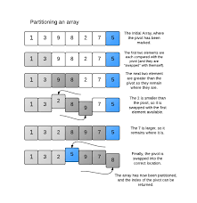
In-Place Quick-Sort (2)
The recursive calls consider
Elements with rank less than h
Elements with rank greater than k

Slide 44
In-Place Quick-Sort Algorithm
Algorithm inPlaceQuickSort(S, l, r)
Input sequence S, ranks l and r
Output sequence S with the elements of rank between l and r rearranged in increasing order
if l ≥ r
return
i ← a random integer between l and r
x ← S.elemAtRank(i)
(h, k) ← inPlacePartition(x)
inPlaceQuickSort(S, l, h − 1)
inPlaceQuickSort(S, k + 1, r)

Slide 45
In-Place Partitioning
Perform the partition using two indices to split S into L and E U G (a similar method can split E U G into E and G)
Repeat until j and k cross:
Scan j to the right until finding an element > x
Scan k to the left until finding an element < x
Swap elements at indices j and k
j
k
3 2 5 1 0 7 3 5 9 2 7 9 8 9 7 6 9
(pivot = 6)
j
k
3 2 5 1 0 7 3 5 9 2 7 9 8 9 7 6 9

Slide 46
Summary of Sorting Algorithms
Algorithm | Time | Notes
selection-sort | O(n²) | in-place slow (good for small inputs)
insertion-sort | O(n²) | in-place slow (good for small inputs)
quick-sort | O(n log n) expected | in-place, randomized fastest (good for large inputs)
heap-sort | O(n log n) | in-place fast (good for large inputs)
merge-sort | O(n log n) | sequential data access fast (good for huge inputs)

Slide 47
Bucket-Sort and Radix-Sort
1, c
3, a
3, b
7, d
7, g
7, e
∅
∅
∅
∅
∅
∅
∅
B
0
1
2
3
4
5
6
7
8
9

Slide 48
Bucket-Sort (1)
Let be S be a sequence of n (key, element) entries with keys in the range [0, N - 1]
Bucket-sort uses the keys as indices into an a bucket array that has cells indexed from 0 to N-1
Not based on comparisons

Slide 49

Bucket-Sort (2)
Phase 1: Each entry with k is placed into the bucket B[k] which is a sequence of entries with key k
Phase 2: After inserting each entry of sequence S into a B[k], the entries are moved back into S in sorted order by enumerating the contents of the buckets, B[i] where i=0,..,N-1 in order

Slide 50
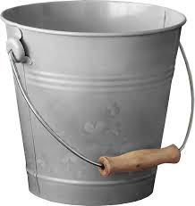
Bucket-Sort Algorithm
Algorithm bucketSort(S, N)
Input: sequence S of (key, element items with keys in the range [0, N - 1]
Output: sequence S sorted by non-decreasing keys
B ← array of N empty sequences
For each entry e is S do
k←e.getkey()
Remove e from S and insert at of the sequence of B[k]
for i ← 0 to N -1 do
for each entry e in sequence B[i] do
remove e from B[i] and insert at the end of S

Slide 51

Bucket-Sort Example
Key range [0, 9]
7, d
1, c
3, a
7, g
3, b
7, e
Phase 1
1, c
3, a
3, b
7, d
7, g
7, e
B
0
1
2
3
4
5
6
7
8
9
∅
∅
∅
∅
∅
∅
∅
Phase 2
1, c
3, a
3, b
7, d
7, g
7, e

Slide 52
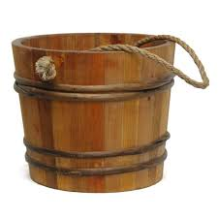
Bucket-Sort Analysis:
Phase 1 takes O(n) time
Phase 2 takes O(n + N) time
Bucket-sort takes O(n + N) time
n is the number of entries
N is the number of buckets

Slide 53
Bucket-Sort Properties (1)
Uses a key-type property
The keys are used as indices into an array and cannot be arbitrary objects
There is not an external comparator

Slide 54
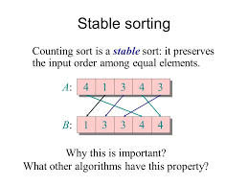
Bucket-Sort Properties (2)
Stable Sort Property
The relative order of any two items with the same key is preserved after the execution of the algorithm
If (k_{i},x_{i}) precedes (k_{i},x_{j}) initially in S then (k_{i},x_{i}) will precede (k_{i},x_{j}) after the algorithm where k_{i}= k_{i}

Slide 55
Lexicographic Order
Suppose one wants to sort entries with keys that are pairs (k,l) where k and l are integers in the range [0,N-1]
A lexicographic order on these keys:
(k₁,l₁) < (k₂,l₂) if k₁< k₂ or k₁= k₂ and l₁ < l₂

Slide 56

Lexicographic Order (Generalized)
A d-tuple is a sequence of d keys (k₁, k₂, …, k_{d}), where key k_{i} is said to be the i-th dimension of the tuple
Example:
The Cartesian coordinates of a point in space are a 3-tuple
The lexicographic order of two d-tuples is recursively defined as follows
(x₁, x₂, …, x_{d}) < (y₁, y₂, …, y_{d}) ⇔ x₁ < y₁ or x₁ = y₁ and (x₂, …, x_{d}) < (y₂, …, y_{d})
i.e., the tuples are compared by the first dimension, then by the second dimension, etc.

Slide 57

Overview of the Radix-Sort
Sorting a sequence S with keys that are ordered pairs (k,l)
Apply the stable bucket-sort twice
First using one component of the pairs as the ordering key
Second using the other component

Slide 58
Radix-Sort Example
S=(3, 3) (1, 5) (2,5) (1, 2) (2, 3) (1,7) (3, 2) (2, 2)
Using the first component
S₁=(1,5) (1,2) (1,7) (2, 5) (2, 3) (2,2) (3, 3) (3, 2)
Then using the second component
S1,2 =(1,2) (2,2) (3,2) (2, 3) (3, 3) (1,5) (2, 5) (1, 7)
Using the second component
S2 =(1,2) (3,2) (2,2) (3, 3) (2, 3) (1,5) (2, 5) (1, 7)
Then using the first component
S2,1 =(1,2) (1,5) (1,7) (2, 2) (2, 3) (2,5) (3, 2) (3, 3)
S_{2,1} is lexicographically ordered (using the second component then the first component)

Slide 59
Another Radix-Sort Example
S=(3,3,2) (1,5,0) (2,5,5) (1,2,2) (2,3,0) (1,7,2) (3, 2,1)
S₁=(1,5,0) (1,2,2) (1,7,2) (2,5,5) (2,3,0) (3,3,2) (3,2,1)
S₃=(1,5,0) (2,3,0) (3,2,1) (3,3,2) (1,2,2) (1,7,2) (2,5,5)
S_{3,2}=(3,2,1) (1,2,2) (2,3,0) (3,3,2) (1,5,0) (2,5,5) (1,7,2)
S_{3,2,1}=(1,2,2) (1,5,0) (1,7,2) (2,3,0) (2,5,5) (3,2,1) (3,3,2)
S_{3,2,1} is lexicographically ordered

Slide 60
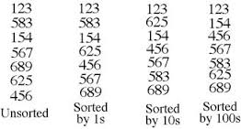
Radix-Sort Algorithm
Algorithm radixSort(S, N)
Input sequence S of d-tuples such
that (0, …, 0) ≤ (x₁, …, x_{d}) and (x₁, …, x_{d}) ≤ (N-1, …, N-1) for each tuple (x₁, …, x_{d}) in S Output sequence S sorted in lexicographic order
for i ← d down to 1
bucketSort(S, N)

Slide 61
Radix-Sort Summary
Radix-sort is a specialization of lexicographic-sort that uses bucket-sort as the stable sorting algorithm in each dimension
Radix-sort is applicable to d-tuples with keys (k₁, k₂, …, k_{d}) in the range [0, N − 1]
Radix-sort runs in time O(d(n + N)) for a d-tuple

Slide 62
Radix-Sort for Binary Numbers
Consider a sequence of n b-bit integers x = x_{b − 1} … x₁x₀
One represents each element as a b-tuple of integers in the range [0, 1] and apply radix-sort with N = 2
This application of the radix-sort algorithm runs in O(bn) time
For example, one can sort a sequence of 32-bit integers in linear time

Slide 63
Sorting a Sequence of 4-bit Integers
1001
0010
1001
1001
0001
0010
1110
1101
0001
0010
1101
1001
0001
0010
1001
0001
1101
0010
1101
1101
1110
0001
1110
1110
1110

Slide 64
Summary of Sorting Algorithms

Slide 65

Selection

Slide 66
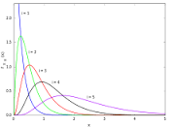
Order Statistics
There are some applications where one is interested in identifying a single element is terms of its rank relative to an ordering of the entire set
Finding minimums and maximums
Finding medians
Half the elements are smaller and half the elements are larger
Queries that ask for an element with a given rank are called order statistics

Slide 67

Defining the Selection Problem
Selection process
Given an integer k and n elements x₁, x₂, …, x_{n}, find the k^{th} smallest element with a total ordered relation in an unordered set
Of course, one can sort the set in O(n log n) time and then index the k^{th} element
This problem can be solved faster
k=3
7 4 9 6 2 → 2 4 6 7 9

Slide 68
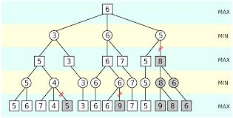
Prune-and-Search
This problem can be solved in O(n) time for any value of k using a design pattern called prune-and-search or decrease-and conquer
Prune away a portion of the n objects
Then recursively solve the smaller problem
Finally use the brute force method
The binary search method is an example of prune-and-search

Slide 69

Randomized Quick-Select (1)
Quick-select is a randomized selection algorithm based on the prune-and-search paradigm to find the k^{th} smallest element in an unordered sequence of n elements where a total order relation is defined
Runs in O(n) expected time
Average case is O(n)
O(n²) in the worst case

Slide 70
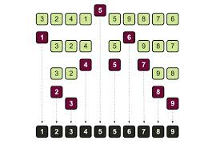
Randomized Quick-Select (2)
Given an unordered set of n elements and k between 1 and n inclusive, the quick select algorithm is similar to the quick sort algorithm

Slide 71

Randomized Quick-Select (3)
Prune: pick a random element x (called the pivot) and partition S into
L elements less than x
E elements equal x
G elements greater than x
Search: depending on k, either answer is in E, or either L or G
Prune again if necessary (if not in E)

Slide 72
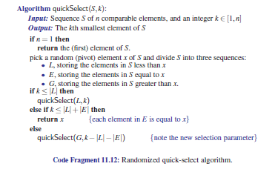
Randomized Quick-Select

Slide 73
Randomized Quick-Select - 4
x
x
L
G
E
k < |L|
k > |L|+|E|
k’ = k - |L| - |E|
|L| < k < |L|+|E|
(done)
Prune L or G depending on k (then recur)

Slide 74
Quick-Select Visualization
An execution of quick-select can be visualized by a recursion path
Each node represents a recursive call of quick-select, and stores k and the remaining sequence
k=5, S=(7 4 9 3 2 6 5 1 8)
k=2, S=(7 4 9 6 5 8)
k=2, S=(7 4 6 5)
k=1, S=(7 6 5)
5

Slide 75
Expected Running Time
Consider a recursive call of quick-select on a sequence of size s
Good call: the sizes of L and G are each less than 3s/4
Bad call: one of L and G has size greater than 3s/4
A call is good with probability 1/2
1/2 of the possible pivots cause good calls:
7 2 9 4 3 7 6 1 9
7 2 9 4 3 7 6 1
2 4 3 1
7 9 7 1 → 1
1
7 2 9 4 3 7 6
Good call
Bad call
1 2 3 4 5 6 7 8 9 10 11 12 13 14 15 16
Bad pivots
Good pivots
Bad pivots

Slide 76
Sets

Slide 77
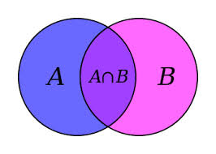
Sets
A collection of distinct objects
Duplicates are not allowed
No keys
No explicit notation of order however sets can be ordered

Slide 78

Set ADT Methods
insert(e)
Insert the element e into S and return an iterator referring to its location; if the element already exists the operation is ignored
find(e)
If S contains e, return an iterator referring to this entry; else return end;
erase(e)
Remove the element e from S
begin()
Return an iterator to the beginning of S
end()
Return an iterator to the end of S

Slide 79
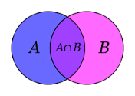
STL Set
The set STL is implemented by adapting the STL ordered map (which is based on a red-black tree)
The set STL supports the previous methods plus
lower_bound(e)
Returns an iterator to the largest element less than or equal to e
upper_bound(e)
Returns an iterator to the smallest element greater than or equal to e
equal_range(e)
Returns an iterator range of elements than are equal to e

Slide 80
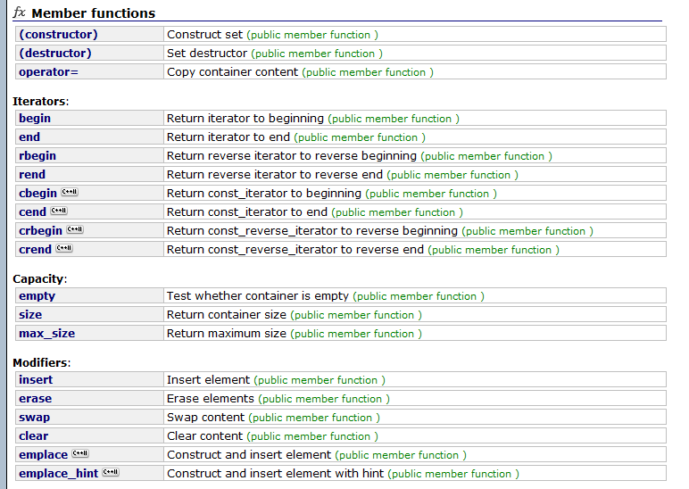
STL Set Methods - 1
http://www.cplusplus.com/reference/set/set/

Slide 81
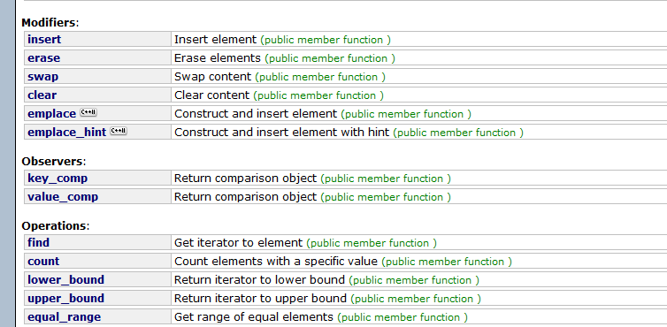

STL Set Methods - 2

Slide 82
Example Using the STL Set
#include <iostream>
#include <set>
int main ()
{
std::set<int> myset;
std::set<int>::iterator it;
// set some initial values:
for (int i=1; i<=5; i++) myset.insert(i*10); // set: 10 20 30 40 50
it=myset.find(20);
myset.erase (it);
myset.erase (myset.find(40));
std::cout << "myset contains:";
for (it=myset.begin(); it!=myset.end(); ++it)
std::cout << ' ' << *it;
std::cout << '\n';
return 0;
}
Output
myset contains: 10 30 50

Slide 83
Another Example Using the STL Set
// set::lower_bound/upper_bound
#include <iostream>
#include <set>
using namespace std;
int main ()
{
set<int> myset;
set<int>::iterator itlow,itup;
for (int i=1; i<10; i++) myset.insert(i*10); // 10 20 30 40 50 60 70 80 90
itlow=myset.lower_bound (30); // ^
itup=myset.upper_bound (60); // ^
myset.erase(itlow,itup); // 10 20 70 80 90
cout << "myset contains:";
for (set<int>::iterator it=myset.begin(); it!=myset.end(); ++it)
cout << ' ' << *it;
cout << '\n';
return 0;
}
Output
myset contains: 10 20 70 80 90

Slide 84
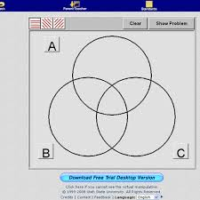
Mergable Sets
Extension of the ordered set ADT
Allows for operations between sets

Slide 85
Set Definitions
= {x| x is in A or x is in B}
= {x| x is in A and x is in B}
={x| x is in A and x is not in B}
Internet searches use these definitions

Slide 86
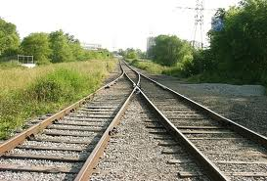
Fundamental Methods of the Mergable Set ADT
union(B) – Replaces A with the union of A and B
A ←
intersect(B) – Replaces A with the intersection n of A and B
A ←
subtract(B) – Replaces A with the difference of A and B
A ←

Slide 87
Mergable Set Implementation
A simple way to implement a mergable set is to store its elements in an ordered sequence
Union, intersect, and subtract can easily be implemented based on a < b, a = b, or a > b
For example, for union: C
If a < b, copy a to the end of C and advance to the next element of A
If a = b, copy a to the end of C and advance to the next element of A and b
If a > b, copy b to the end of C and advance to the next element of B
←

Slide 88
Performance of Generic Merging
Assuming the sets are ordered
At each iteration
One compares two elements of the input sequences A and B
Possibly copies one element to the output sequence
Advance the current element of A, B, or both
Assuming that comparing and copying elements takes O(1) time, the total running is O(n_{A} + n_{B}) where n_{A} is the size of A and n_{B} is the size of B
Run time is O(n) where n is the sum of the sizes of the sets

Slide 89

Template Method Pattern
The template method pattern is a software engineering design pattern describing a generic computation mechanism that can be specialized by redefining certain steps

Slide 90
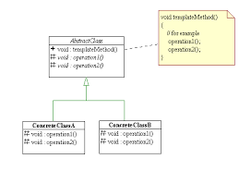
Template Design Pattern
Defines the program skeleton of an algorithm in a method, called a template method, which defers some steps to subclasses
It lets one redefine certain steps of an algorithm without changing the algorithm's structure
This use of "template" is unrelated to C++ templates

Slide 91
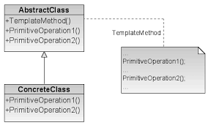
Template Design Pattern
In the template method of this design pattern, one or more algorithm steps can be overridden by subclasses to allow differing behaviors while ensuring that the overarching algorithm is still followed

Slide 92
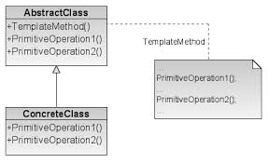
Template Design Pattern Implementation
First a class is created that provides the basic steps of an algorithm design
These steps are implemented using abstract methods
Later on, subclasses change the abstract methods to implement real actions
Thus the general algorithm is saved in one place but the concrete steps may be changed by the subclasses
See template.cpp

Slide 93
Generic Merging as a Template Method Pattern
One can developed a design method that mergers two sequences into one by specializing the behavior of three abstract methods (pure virtual functions)
fromA
Next element will be selected from A
fromB
Next element will be selected from B
fromBoth
Next element will be selected from both A and B

Slide 94
Generic Merging as a Template Method Pattern
template <typename E>
class Merge { // generic Merge
public: // global types
typedef std::list<E> List; // list type
void merge(List& A, List& B, List& C); // generic merge function
protected: // local types
typedef typename List::iterator Itor; // iterator type
// overridden functions
virtual void fromA(const E& a, List& C) = 0;
virtual void fromBoth(const E& a, const E& b, List& C) = 0;
virtual void fromB(const E& b, List& C) = 0;
};

Slide 95
Generic Merging as a Template Method Pattern
fromA, fromB and fromBoth
Are overridden in subclasses of Merge to achieve the desired results
Subclasses of the Merge
UnionMerge
IntersectMerge
SubtractMerge
All methods run in linear time

